Slide 1



Credit Card Approval Prediction
A Machine Learning Project
Programme Name: Bachelor of Technology (Computer Science and Engineering)
LOVELY PROFESSSIONAL UNIVERSITY

Slide 2
Submitted To: Dr. Dhanpratap Singh
We would like to express our deepest gratitude to Dr. Dhanpratap Singh for his exceptional guidance, unwavering support, and invaluable expertise throughout the course of this project. Dr. Singh's profound knowledge in the field of credit card approval prediction has been instrumental in shaping our journey and ensuring the development of an accurate and reliable prediction system.
Dr. Singh's profound expertise in credit card approval prediction models, combined with his passion for empowering students, has truly made a remarkable impact on our learning experience. His unwavering commitment to our growth and his dedication to helping us succeed have been nothing short of inspiring.

Slide 3

Submitted by
Hari Prasad Boddepalli
12112271
Ayush Gupta
12105138
Abhinandhan
12108947

Slide 4
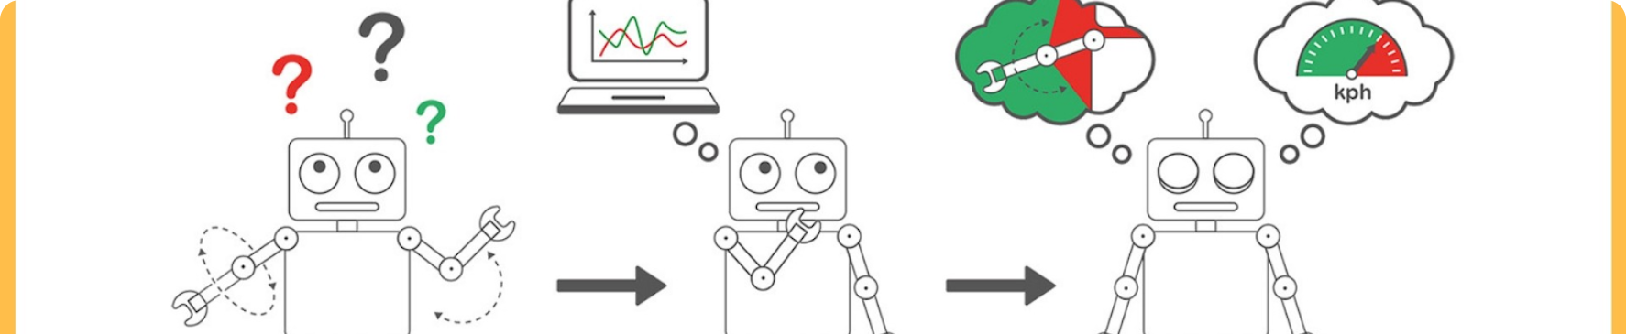
Introduction
Credit cards are a popular and widely used form of payment in today's world. They offer a convenient and secure way to make purchases, both online and offline. However, the process of approving credit card applications can be time-consuming and complex, often involving manual reviews and subjective decision-making. To address this, we have explored the use of machine learning algorithms to automate and improve the credit card approval process.
By leveraging machine learning, we can analyze large volumes of data, identify patterns and trends, and make more accurate and consistent credit decisions.

Slide 5

What is a Credit Card
A credit card is a financial product offered by banks and NBFCs (Non-Banking Financial Companies) that allows individuals to borrow money from a line of credit. It provides users with a convenient way to make purchases and pay for them later.
Credit cards offer various benefits to cardholders. They provide a safe and secure way to make online transactions, offer rewards and cashback programs, and can help build a good credit history when used responsibly. However, it's important to be aware of the potential disadvantages, such as high interest rates, fees, and the risk of overspending.

Slide 6

Credit Scoring and Decisioning Models
Credit scoring is a statistical analysis used by lenders to assess the creditworthiness of individuals. Factors such as credit history and personal information are considered to generate a credit score, indicating the borrower's risk level.
Credit decisioning involves evaluating credit applications and determining the borrower's creditworthiness and profitability. It plays a crucial role in the lending industry as it helps lenders make informed decisions about whether to approve or decline credit applications.

Slide 7

How Machine Learning is Transforming Credit Card Customer Experience
Machine learning and artificial intelligence have revolutionized the credit card industry. These technologies analyze vast amounts of data to detect fraud and provide personalized financial trajectories. By leveraging machine learning, credit card companies are able to automate tasks and find patterns in data that were previously impossible to detect. This enables them to identify potential fraudsters and protect their customers from unauthorized transactions. Moreover, machine learning algorithms can provide personalized financial trajectories to credit card holders. By analyzing individual spending patterns, these algorithms can offer tailored recommendations for budgeting, saving, and investment options. The implementation of machine learning systems in the credit card industry has also greatly enhanced the overall customer experience. With advanced algorithms, credit card companies can now offer seamless and frictionless transactions to their customers. This includes real-time fraud detection, instant approval processes, and personalized customer support.

Slide 8

Comparison of Different Supervised Machine Learning
In our study, we focused on predicting credit card approval using a limited number of machine learning algorithms. The decision tree and k-nearest neighbor algorithms achieved high training and testing accuracies. However, further research is needed to explore other classification algorithms that may yield even better results.

Slide 9
Advantages of a Credit Card
EMI Option
Exciting Offers and Cashbacks
Credit cards offer the convenience of low monthly EMI payments, making it easier to purchase goods and services.
Various banks provide credit cards with exciting offers and cashbacks, allowing users to enjoy discounts on online and offline purchases.
Protection of Purchase
Improving Credit Score
Credit cards offer insurance for lost, damaged, or stolen purchases, providing users with peace of mind backed by credit card statements.
Using a credit card responsibly helps build a credit line, which is vital for future loan or rental applications.

Slide 10
Advantages of a Credit Card
Enhanced Accuracy
Faster Processing
Machine learning algorithms analyze various data points like credit history, income, and spending patterns to make accurate credit card approval decisions.
Machine learning automates manual reviews and paperwork, expediting the credit card approval process.
Personalized Offerings
Risk Mitigation
Machine learning enables lenders to tailor credit card features based on individual profiles and preferences, providing personalized offerings to customers.
Machine learning algorithms assess creditworthiness, protecting lenders from potential losses and ensuring responsible lending practices.

Slide 11
Disadvantages of a Credit Card
Hidden Costs
Restricted Drawings
Credit cards often come with hidden costs such as late payment fees and processing fees, which can increase overall expenses.
Credit cards charge additional fees for cash withdrawals, making them less beneficial than debit cards for such transactions.

Slide 12
Challenges of Credit Card Approval Using Machine Learning
Predicting credit card approval using machine learning algorithms presents several challenges that need to be addressed:
1
Data Privacy and Security
2
Model Interpretability and Transparency
3
Bias and Fairness
Machine learning algorithms used for credit card approval must be monitored to ensure fairness and mitigate any biases that may arise.
Protecting sensitive customer data through robust data privacy and security measures is crucial for maintaining trust and compliance.
Developing transparent models that can explain credit card approval decisions is essential for regulatory compliance and building consumer trust.

Slide 13
Future Scope
1
Deep Learning Models
2
Automation
To further improve the credit card approval system, future research can explore the use of deep learning models such as neural networks.
Implementing this system in an artificial intelligence environment can greatly enhance its efficiency and accuracy. By leveraging the power of AI, the credit card approval process can be automated, reducing manual effort and streamlining the decision-making process.
Deep learning models, like neural networks, have shown great potential in various domains, including credit card approval systems.
Furthermore, automating the credit card approval system through web or desktop applications can provide users with a seamless and convenient experience.

Slide 14


Conclusion
In this study, we have explored various machine learning methods for predicting credit card approval. By leveraging machine learning algorithms, we can streamline the credit card approval process, improve accuracy, and enhance the overall customer experience.
Thank you 😀🙏

